Slide 1
RHI MEDIA LIVE STREAMINNG TRAINING CLASS.
OUTLINE:
- Introduction to Livestreaming
- Uses of Livestreaming
- Components of Livestreaming (Hardware and Software)
- Technicalities of Livestreaming ( Troubleshooting)
-How to schedule stream and Go Live
RH

Slide 2
WHAT IS LIVESTREAMING ?
What is Live Streaming?
Live streaming is the process of transmitting audio and video over the internet in real time,
allowing viewers to watch events as they happen without downloading the content first.
Examples
Church services
Conferences
Weddings
Concerts
Sports
Online classes
Podcast broadcasts
News coverage
Product launches
Gaming

Slide 3
MODULE 2: TYPES OF LIVE STREAMING
- Church Streaming
- Corporate Streaming
- Educational Streaming
- Sports Streaming
- Event Streaming
- Social Media Live
- Podcast Streaming
- Hybrid Events
- Multi-camera Production
- Remote Production

Slide 4
MODULE 3: HOW LIVE STREAMING WORKS
Understand the complete workflow.
- Camera ↓
- Video Switcher ↓
- Computer/Encoder ↓
- Internet ↓
- Streaming Platform ↓
- Viewers

Slide 5
MODULE 4: BASIC TERMINOLOGIES
- Frames Per Second:The number of video frames displayed every second. Common values are 24, 30, and 60 FPS.
- Real-Time Messaging Protocol:
A protocol developed by Adobe for transmitting live audio and video from an encoder to a streaming server. It is the most common protocol for YouTube and Facebook Live.

Slide 6
- Secure Reliable Transport ( SRT) :
An open-source video transport protocol that delivers high-quality, low-latency video securely over unpredictable internet connections.
- Network Device Interface (NDI) :
A technology developed by NewTek that allows video, audio, and metadata to be transmitted over a local network with very low latency.

Slide 7
- Serial Digital Interface( SDI) :
A professional digital video standard used to transmit uncompressed video over coaxial cables, commonly used in broadcast studios.
- High-Definition Multimedia Interface (HDMI):
A digital interface that carries high-definition video and audio through a single cable, commonly used with cameras, TVs, and monitors.

Slide 8
- Universal Serial Bus(USB):
A standard interface used for connecting peripherals such as webcams, microphones, keyboards, capture cards, and storage devices to a computer.
- Universal Serial Bus Type-C (USB-C)
A newer, reversible USB connector capable of carrying data, video, audio, and power.

Slide 9
- Content Delivery Network (CDN):
A network of servers distributed worldwide that delivers live streams and videos efficiently to viewers based on their location.
Empirical Component
- Internet Protocol(IP) :
The communication protocol that identifies devices and enables them to exchange data over a network or the internet.

Slide 10
Local Area Network(LAN):
A network that connects devices within a limited area such as a home, office, church, or studio.
Wide Area Network(WAN):
A network that connects multiple local networks over large geographic distances. The internet is the largest WAN.

Slide 11
- Uniform Resource Locator(URL):
The web address used to access a resource on the internet, such as a streaming server or website.
- Central Processing Unit(CPU):
The main processor of a computer responsible for executing instructions and running software, including streaming applications.

Slide 12
- Domain Name System( DNS):
The system that translates website names (such as youtube.com) into IP addresses that computers can understand.
- Graphics Processing Unit(GPU):
A specialized processor that handles graphics rendering and hardware video encoding, reducing the workload on the CPU.

Slide 13
- Random Access Memory(RAM):
Temporary memory that stores data for active programs, allowing fast access while streaming.
- Solid-State Drive(SSD):
A high-speed storage device that loads software and records video much faster than traditional

Slide 14
- Hard Disk Drive(HDD) :
A traditional mechanical storage device used for storing videos and other files.
- Open Broadcaster Software (officially OBS Studio)
A free, open-source application used for recording and live streaming.

Slide 15
- Megabits Per Second(Mbps)
A unit that measures data transfer speed, commonly used to describe internet upload/download speeds and streaming bitrates.
- Gigabits Per Second( Gbps)
A higher-speed data transfer unit equal to 1,000 Mbps, used for high-speed internet and networking.

Slide 16
- Resolution – The number of pixels in a video (e.g., 1920 × 1080).
- Aspect Ratio – The proportional relationship between a video's width and height (e.g., 16:9).
- Bitrate – The amount of data transmitted per second in a video or audio stream.

Slide 17
- Codec – Software or hardware that compresses and decompresses digital audio or video.
- Encoder – A device or software that converts raw video into a streamable format.
- Decoder – A device or software that converts encoded video back into viewable content.

Slide 18
MODULE 5: INTERNET REQUIREMENTS FOR LIVE STREAMINNG
Recommended Upload Speeds
- 720p 5–10 Mbps
- 1080p 10–20 Mbps
- 4K 25–50 Mbps
Best Internet
- Fiber
- Starlink
- Dedicated Broadband
- Bonded Internet

Slide 19
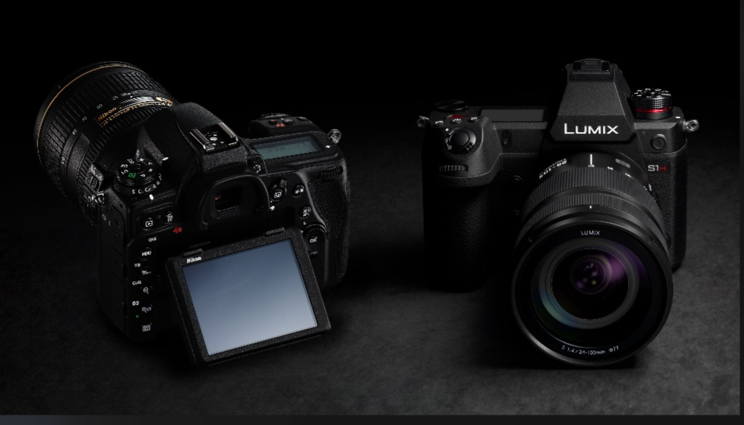
MODULE 6: LIVE STREAMING HARDWARE
- Cameras: DSLR,Mirrorless,Camcorder,PTZ Camera,Cinema Camera,Smartphones.

Slide 20
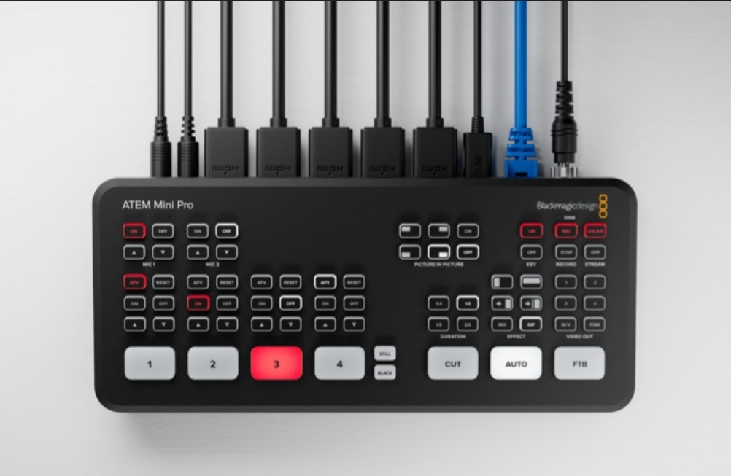
- Video Switchers: ATEM Mini,Roland,vMix Call,Tricaster

Slide 21
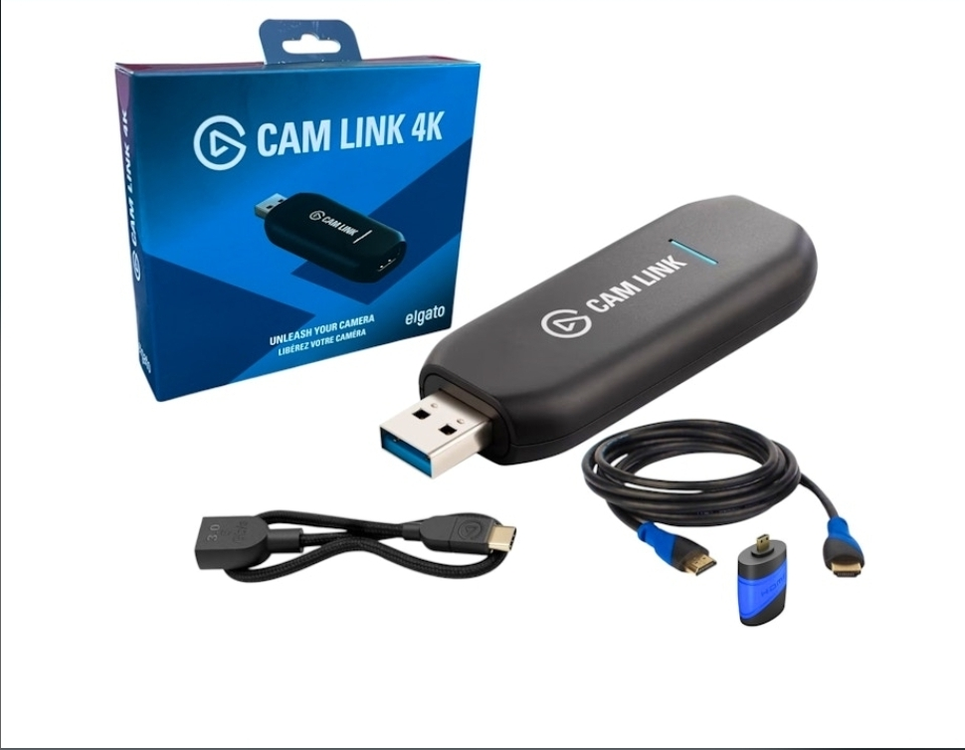
Capture Cards: Elgato,Blackmagic,Magewell,AVerMedia
-

Slide 22
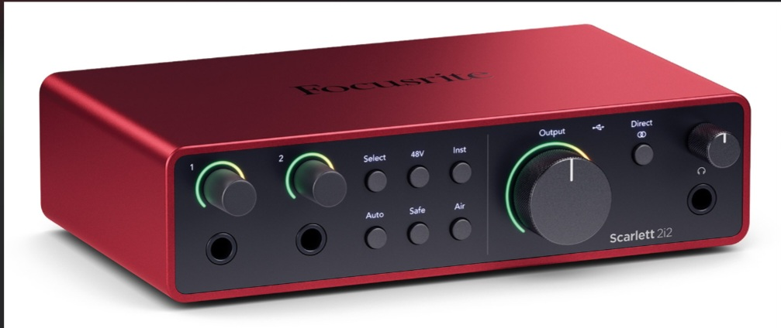
Audio Interfaces: Focusrite,Teyun,Yamaha,Behringer

Slide 23
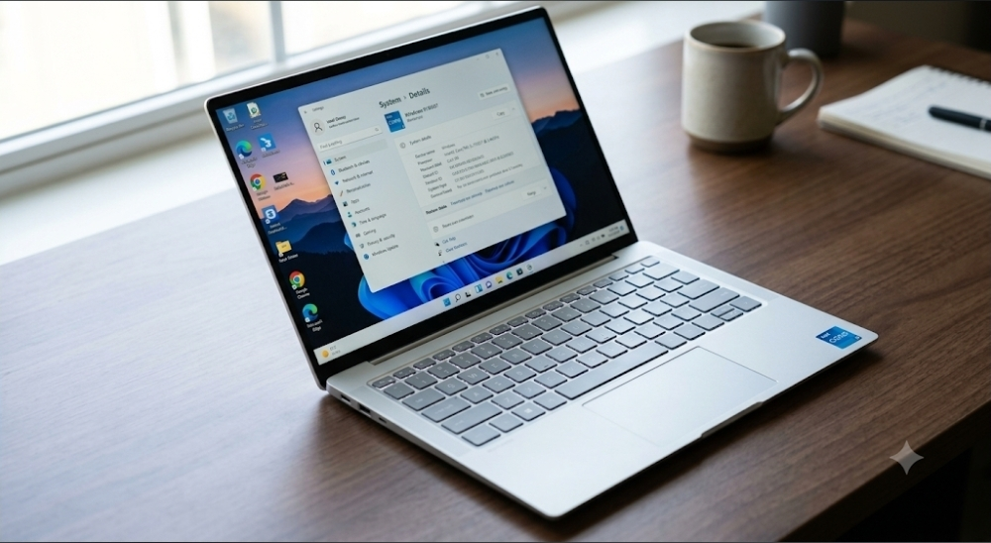
Computers: Minimum Core i5
Recommended
Core i7 Professional,Ryzen 9 Core i9,GPU,NVIDIA RTX,RAM,16GB minimum,32GB recommended

Slide 24
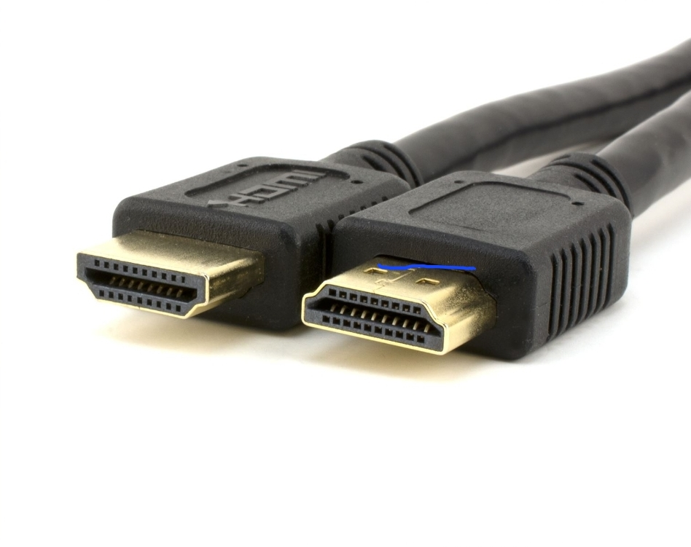
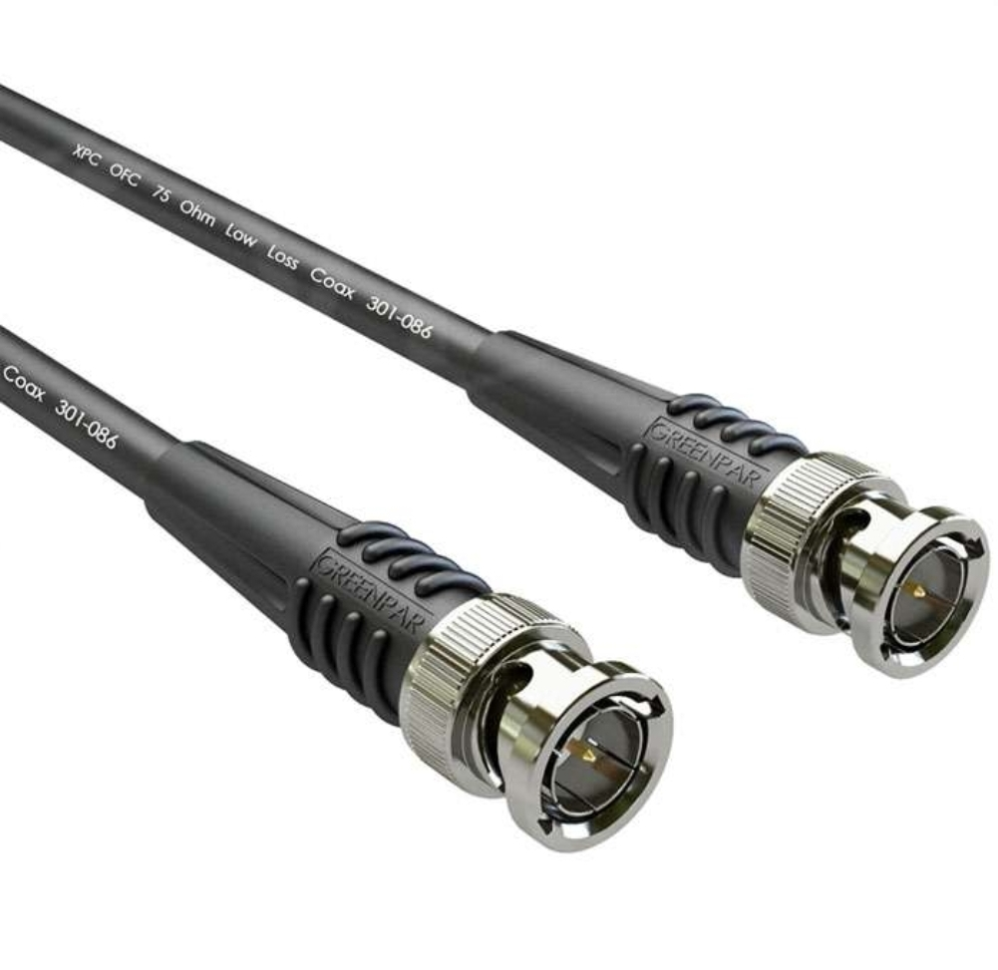
MODULE 9: CABLES FOR LIVESTREAMING
HDMI cables
SDI Cable

Slide 25
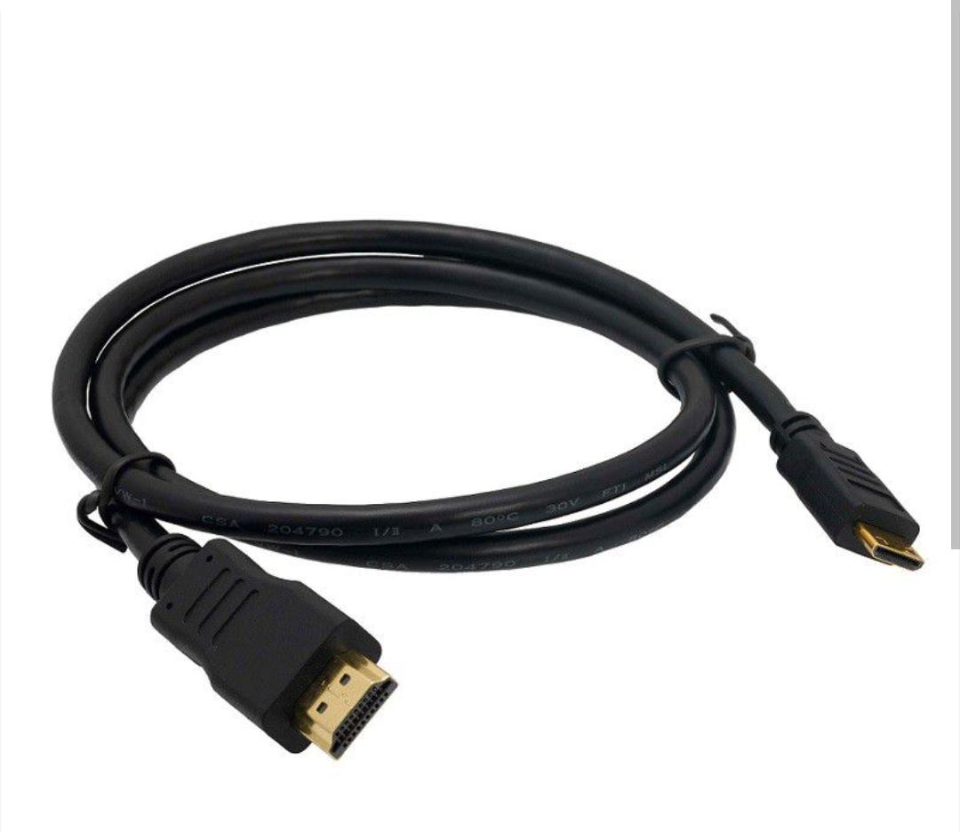
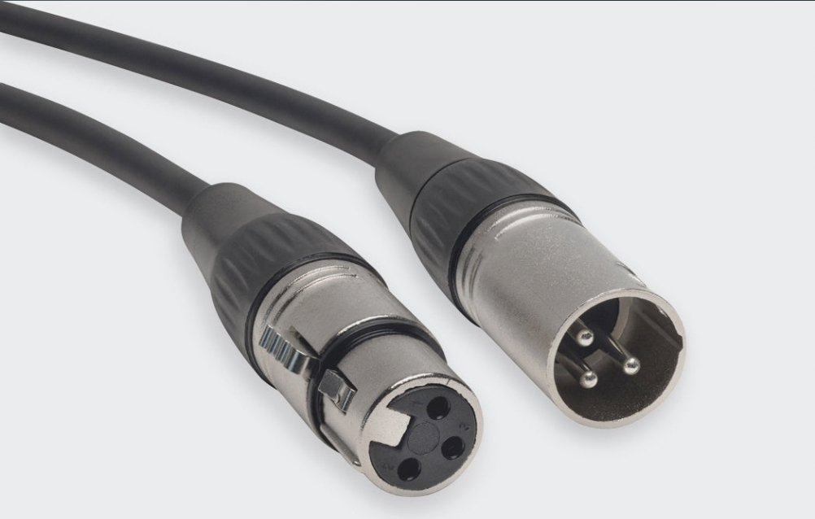
HDMI-USB cable
XLR cable

Slide 26
MODULE 10: LIVE STREAMING SOFTWARE
- OBS Studio
- vMix
- Wirecast
- Ecamm Live
- Streamlabs
- XSplit
- Restream
- Prism Live
- Melon
- Zoom
- Microsoft Teams

Slide 27
MODULE 11: OBS STUDIO MASTERCLASS
- Installation
-Scene Creation
- Sources
Cature,Window Capture.
Features in OBSStudio: Studio mode, Transitions
Audio Mixer, Filters, Recording,Streaming, Replay Buffer, Virtual Camera

Slide 28
MODULE 12: LIVE STREAM PLATFORMS
- YouTube
- Facebook
- Instagram
- TikTok
- X
- LinkedIn
- Twitch
- Kick
- Church Online Platform
- Custom RTMP

Slide 29
Thank You

